Slide 1
Object-Oriented Programming (OOP) vs Procedural Programming (PP)
Notes:
left

Slide 2
Activity
True or False
A C program is not an object-oriented program.
A C++ program is always an object-oriented program.
I can write an object-oriented program in C++.
Name three OOP languages
Name three PP languages

Slide 3
Modern Programming Languages
https://www.devsaran.com/blog/10-best-programming-languages-2020-you-should-know

Slide 4
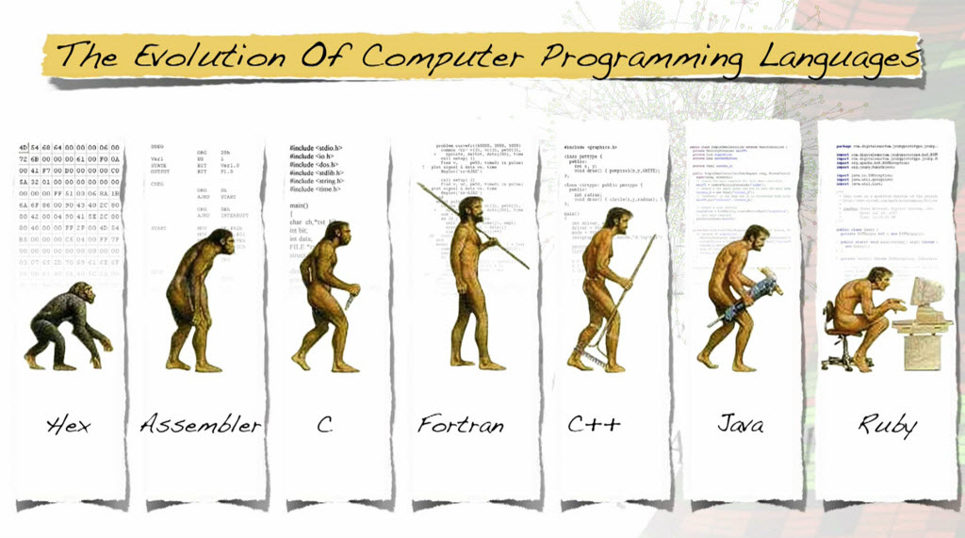
OOP Came After PP
Procedural Programming (PP)
Object-Oriented Programming (OOP)

Slide 5
What is Procedural Programming
Procedural Programs:
are made up of procedures (e.g., routines, subroutines, methods, or functions)
represent a list of instructions telling a computer what to do step by step and how to perform from the first code to the second code
Traditional programming languages were procedural
C, Pascal, BASIC, FORTRAN

Slide 6
Activity
Which program unit is an abstraction of “step by step” and “top-down” design?
What we call this abstraction, i.e. what is the name of this abstraction?

Slide 7
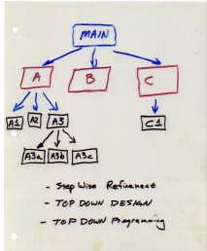
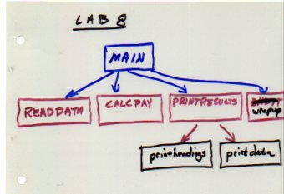
Procedural Programming Design
Top Down Design
Functional decomposition – a problem (procedure) is systematically broken down into sub problems (sub procedures)
Functional decomposition continues until a sub problem is straightforward enough to solve
Notes:
This is where you start with a problem (procedure) and then systematically break the problem down into sub problems (sub procedures). This is called functional decomposition, which continues until a sub problem is straightforward enough to be solved by the corresponding sub procedure. The difficulties with this type of programming, is that software maintenance can be difficult and time consuming. When changes are made to the main procedure (top), those changes can cascade to the sub procedures of main, and the sub-sub procedures and so on, where the change may impact all procedures in the pyramid.

Slide 8
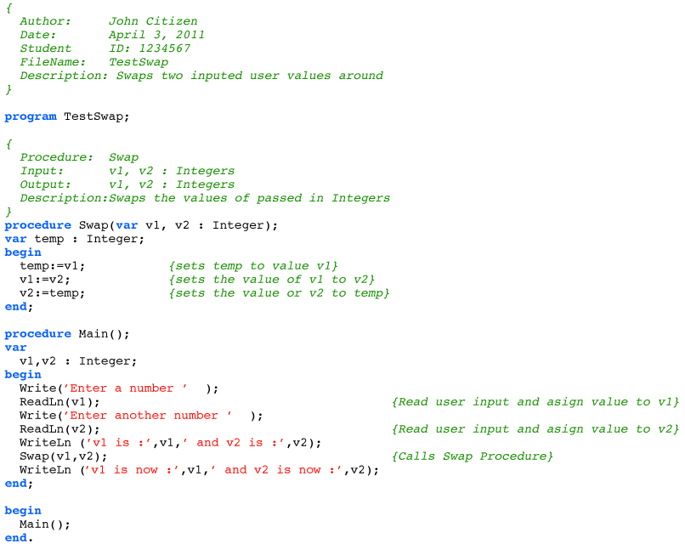
Sample Code in Pascal

Slide 9
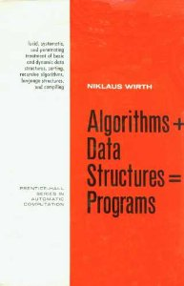
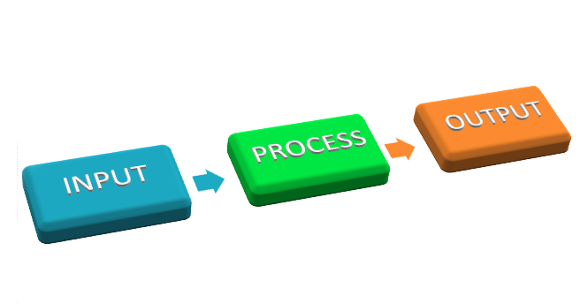
Procedural Programming Design
Algorithms + Data Structures = Programs
Algorithms are implemented in procedures
Procedures take specific data structures as input and generate other types of data as output

Slide 10
Side note
CS department’s curriculum is designed based on PP
Activity: CS1400 – did the instructor teach Java using objects first approach?

Slide 11

Problems with PP - Expressiveness
Procedural languages are difficult to relate with the real world objects.
Disconnected from real world problems.
Notes:
Replace with word “expressiveness”

Slide 12
Problems with PP - Extensibility
Top-down design does not scale with top-level changes
Changes in algorithm or data structures affect each other
Notes:
Add more dynamic points and arrows

Slide 13
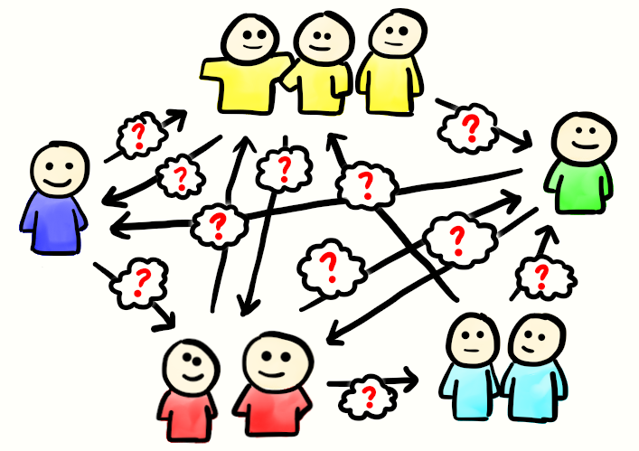
Problems with PP – Security
Data used in procedural languages are exposed to the whole program (procedures)
No security for the data
Notes:
Global Variable
Functions

Slide 14
Activity
What are problems with PP?
Do you agree with the above assessment of PP?

Slide 15
Activity
What are problems with PP?
Problems with PP
Expressiveness
Extensibility
Security
Do you agree with the above assessment of PP?

Slide 16
Motivation for OOP
Real world connection
We build software to solve real world problems.
People have real world problems.
Therefore, we build software for people.
Extensible
Good software not only solves immediate problems, but it can be maintained and modified to address the inevitable changes that the customer will want.
Secure
Exposing data to everywhere prevents the software from being the extensible good software. More importantly, it is not secure.

Slide 17
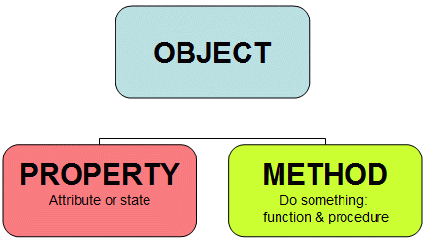
OOP
A class is a combination of state (properties) and behavior (methods)
An object is an instance of a class

Slide 18
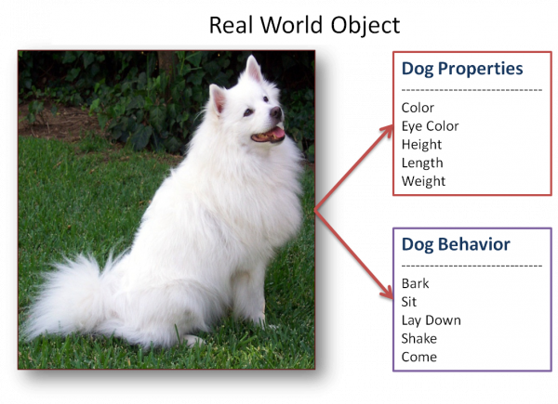
OOP Connects Real World Objects
An inheritance solution requires subclasses to represent each type of view

Slide 19
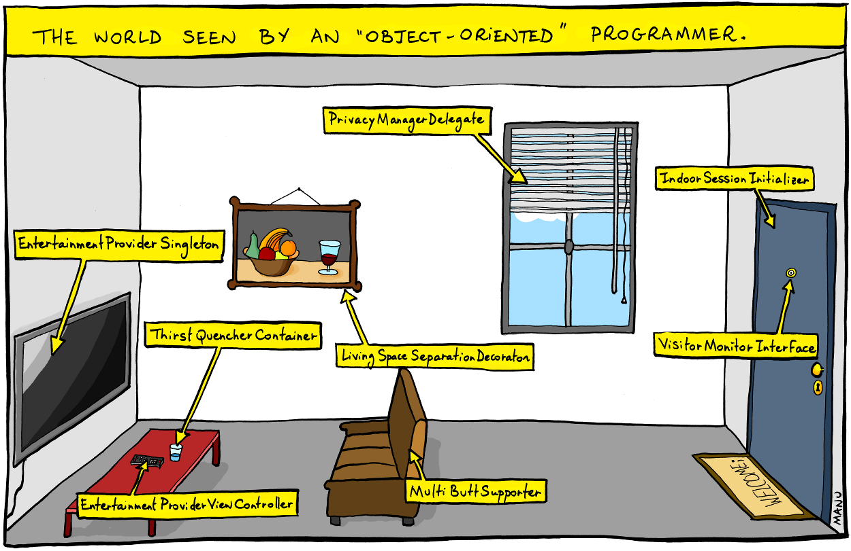
OOP Connects Real World Objects
An inheritance solution requires 15 subclasses to represent each type of view

Slide 20
Activity
What are classes?
What are objects?
What kind of abstraction that OOP promotes?

Slide 21
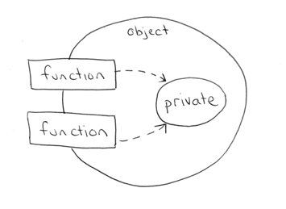
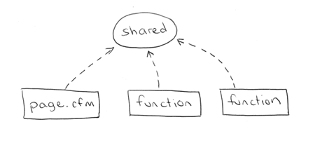
OOP Encapsulates Data
The ability of an object to hide its data and methods from the rest of the world
PP shares the data globally
OOP encapsulates data privately

Slide 22
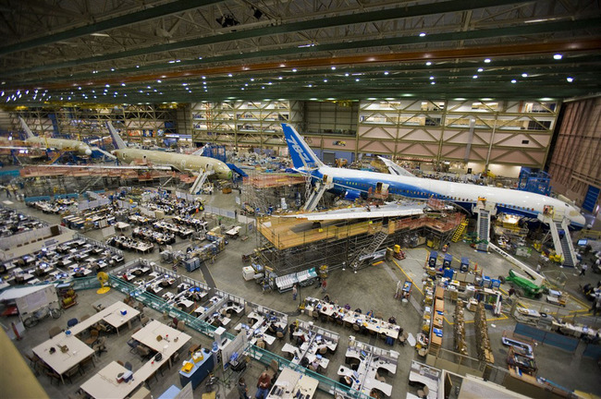
OOP Supports Better Modularity
The source code for a class can be written and maintained independently of the source code for other classes
Once created, an object can be easily passed around inside the system

Slide 23
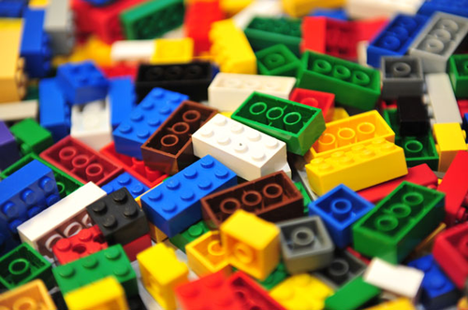
OOP Improves Reuse and Extensibility
If a class already exists, you can use objects from that class in your program.
Object oriented programming languages allow classes to inherit commonly used state and behavior from other classes

Slide 24
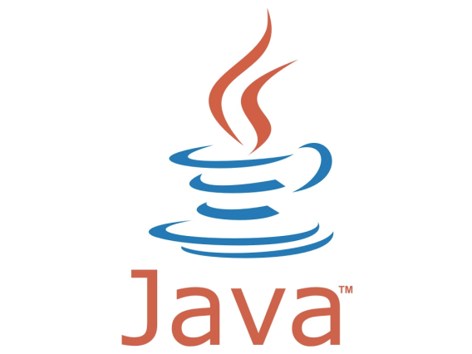

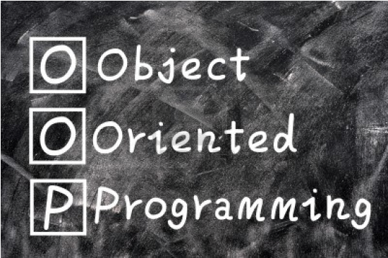
Using Java Doesn’t Mean Using OOP
Using OOP means:
Data encapsulation
Information Hiding
Model problems using objects
Polymorphism

Slide 25
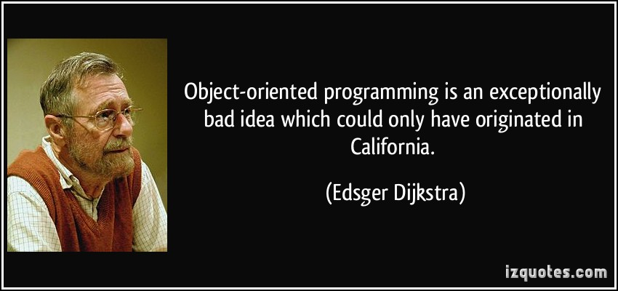
Disadvantages of OOP

Slide 26
Disadvantages of OOP
Not every problem can be considered as objects
e.g., Procedure is not an object
Steep learning curve
PP (Top-down) is more straightforward for us to think
Large program size
Slower programs / Less efficient

Slide 27

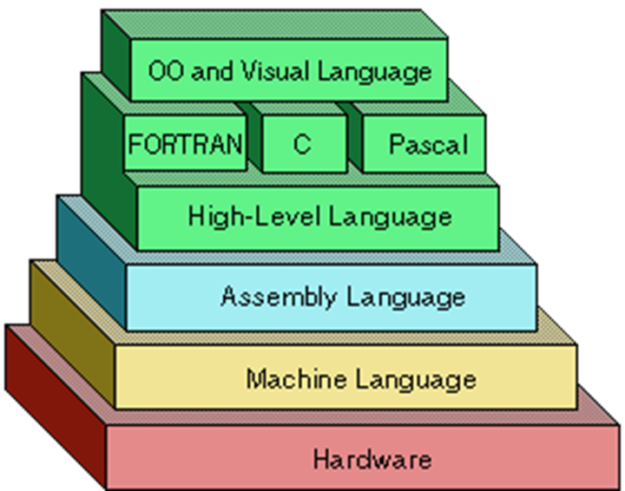
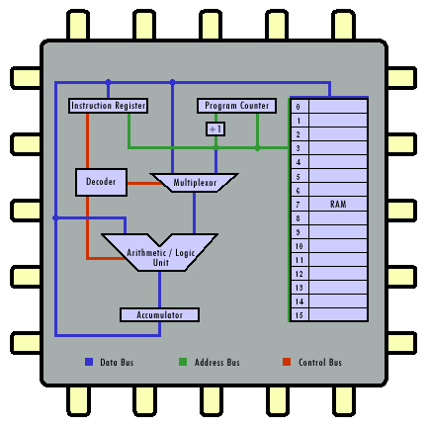
Level of Abstraction

Slide 28
Activity
Did this talk convince everyone that OOP is our current and future trend?
True or False
At least this talk makes me love OOP more.
Count my votes for OOP?

Slide 29
Let’s have more OOPs
End of Lecture PP vs. OOP

